Slide 1
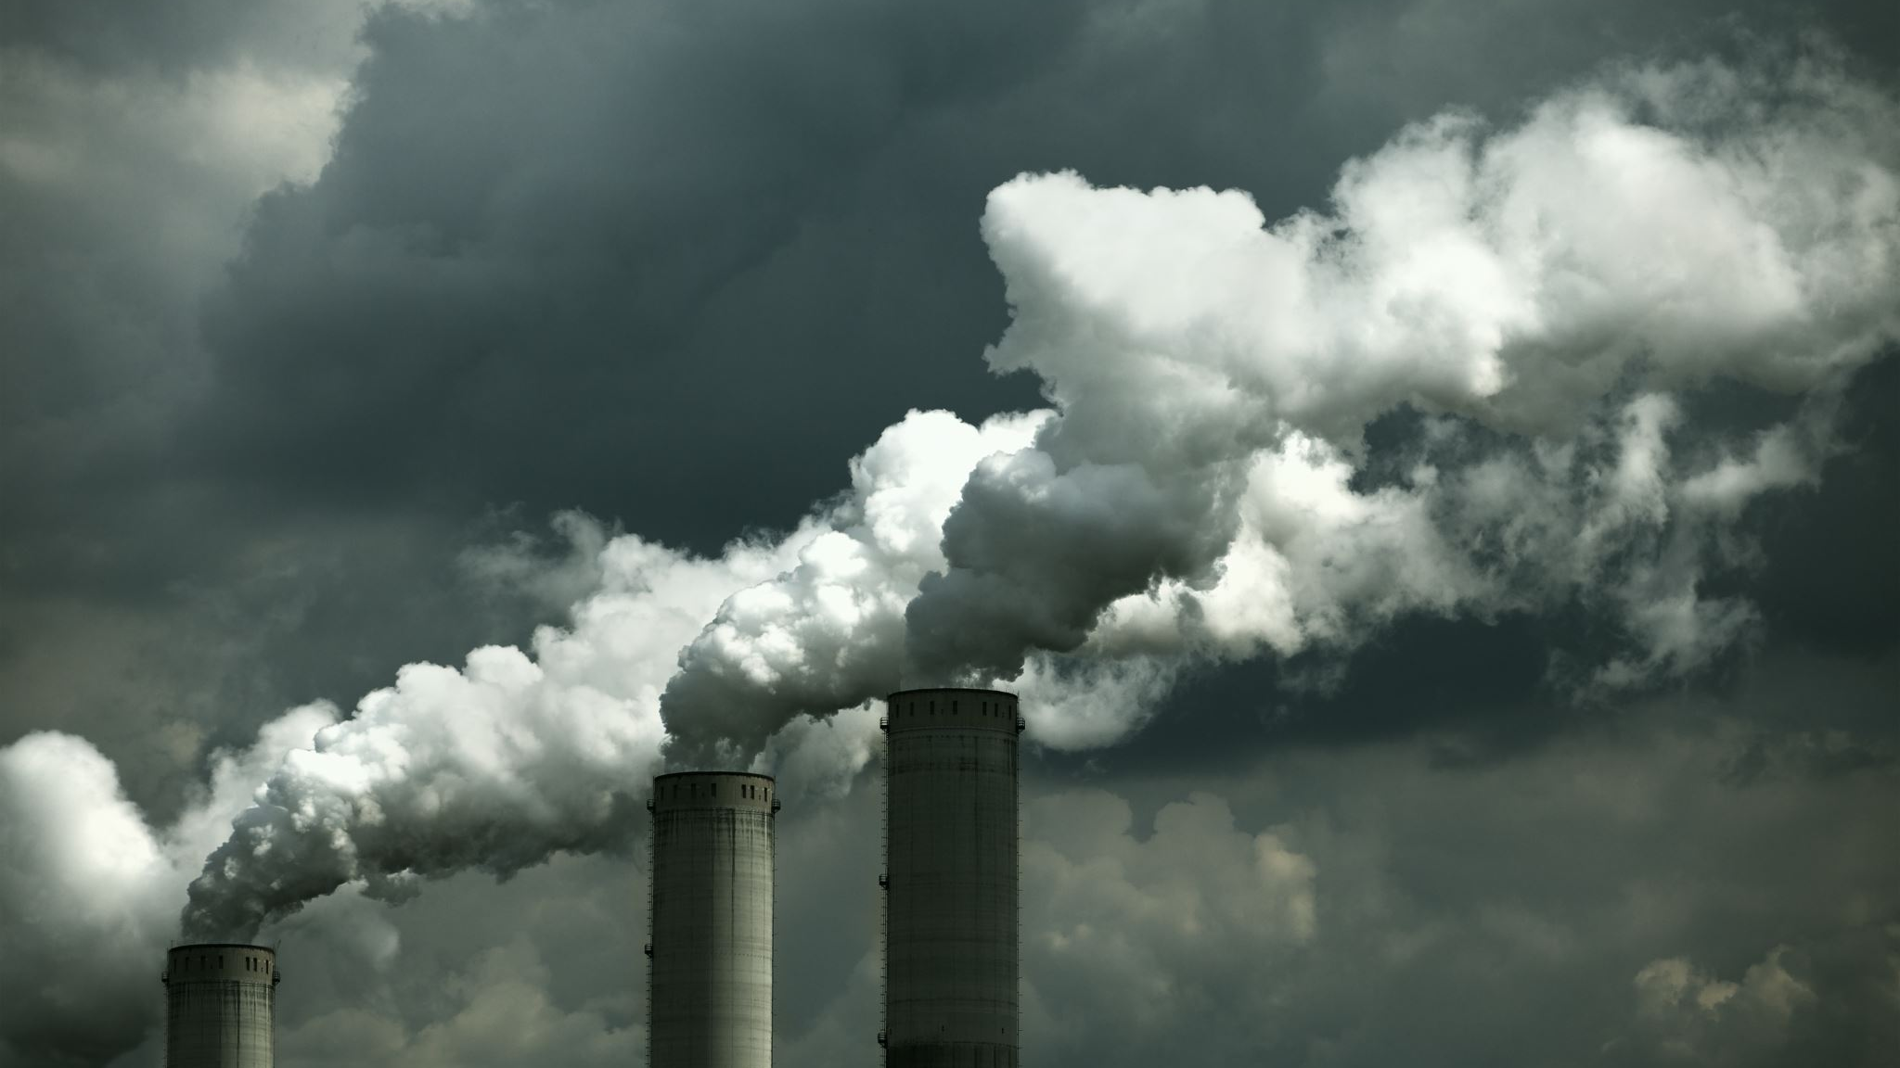
Pollution Predictor

Slide 2
Sucheth Mekala
A20545983
Ankan Mazumdar
A20494478

Slide 3
TABLE OF CONTENTS
Problem statement
Dataset preprocessing
Heatmap
Geo-spacial clustering
3D plot
Feature reduction (Umap)
Propsed model.

Slide 4
PROBLEM STATEMENT
The process of air quality prediction encompasses the estimation of pollutant concentrations and particulate matter levels within the atmosphere at a specific location and time. This is of paramount importance for public health, environmental surveillance, and the execution of prompt measures to alleviate the adverse effects associated with suboptimal air quality. The challenge lies in the development of a machine learning model capable of accurately forecasting air quality levels, drawing upon historical data as well as real-time information. This includes meteorological conditions, pollutant concentrations, and other pertinent features.

Slide 5
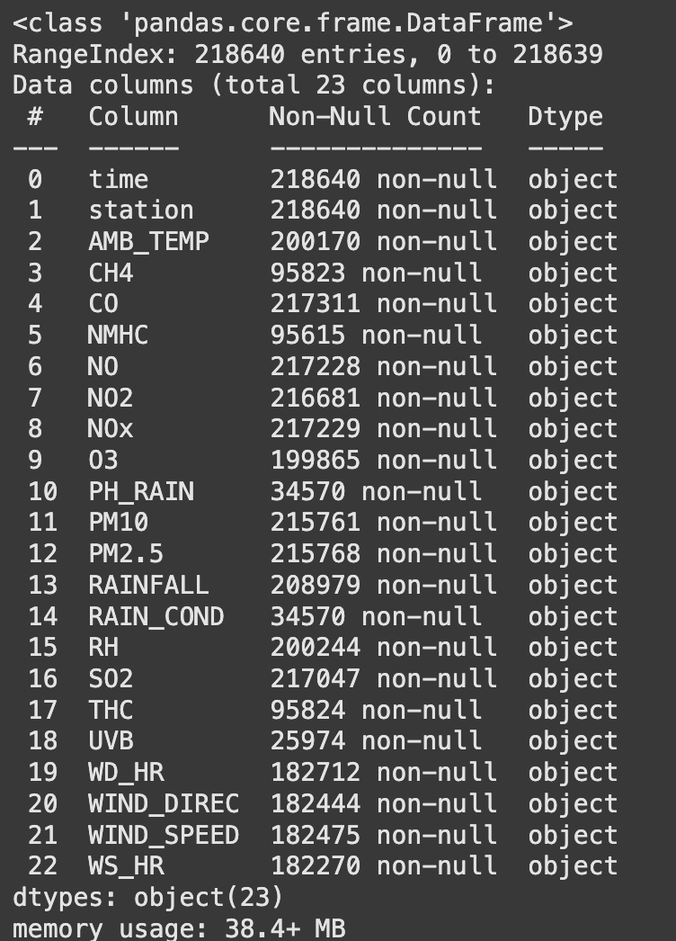
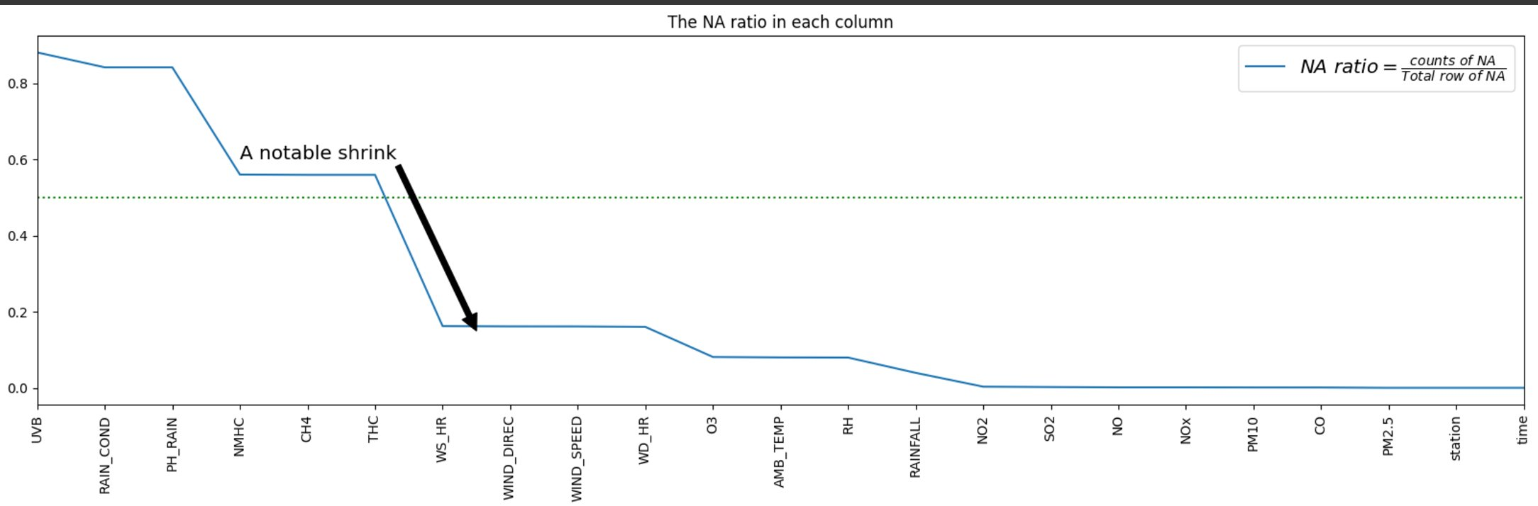
Dataset Description
This dataset has 22 features.
There are many missing values in this dataset
We are predicting pm2.5 as it is the pollution molecules in the air, which we are trying to predict.

Slide 6
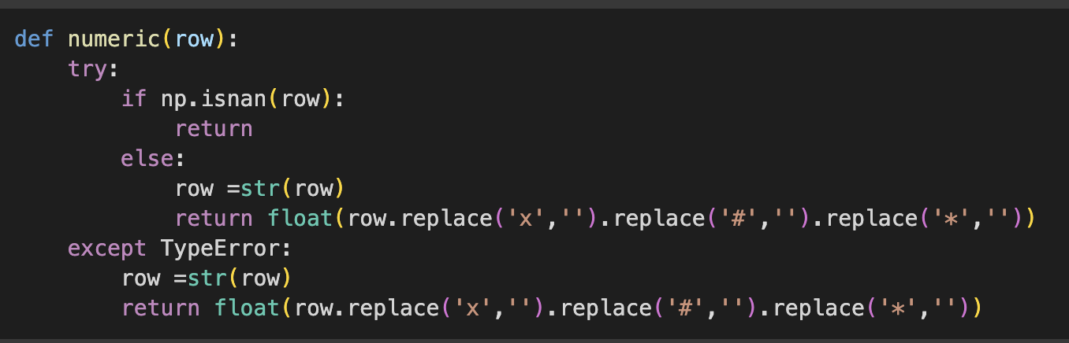
Data Preprocessing
We are dropping the above features cause they have lot of missing values.
There are a lot of datapoints with #, x, * as such this function removes them

Slide 7
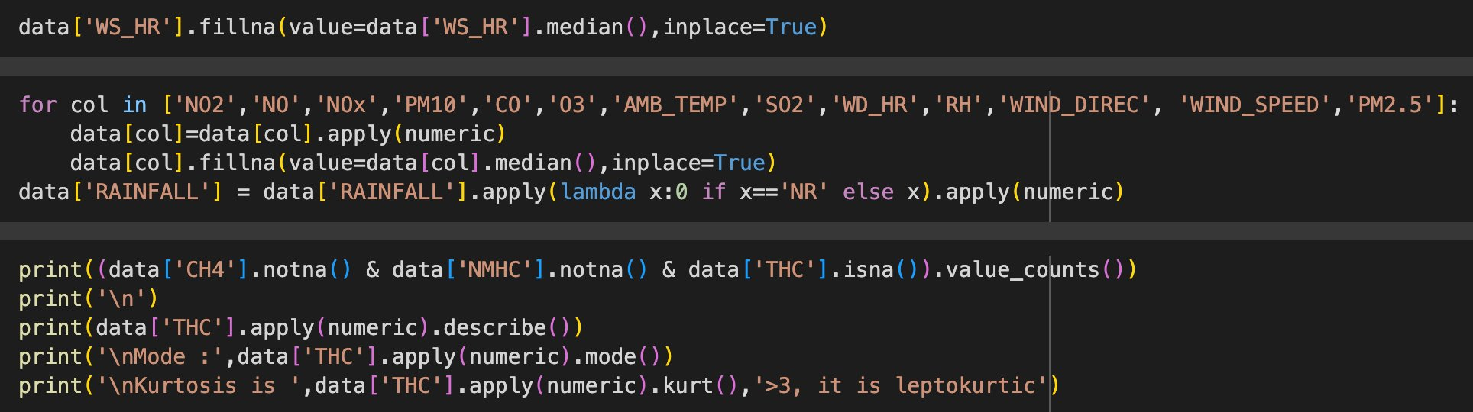
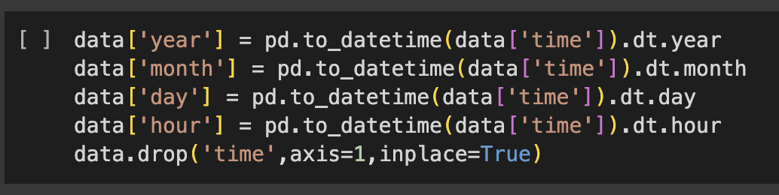
Data preprocessing cont
Time is converted into year,month,day and hour respectively.
Missing values were replaced with median values and mode values.

Slide 8
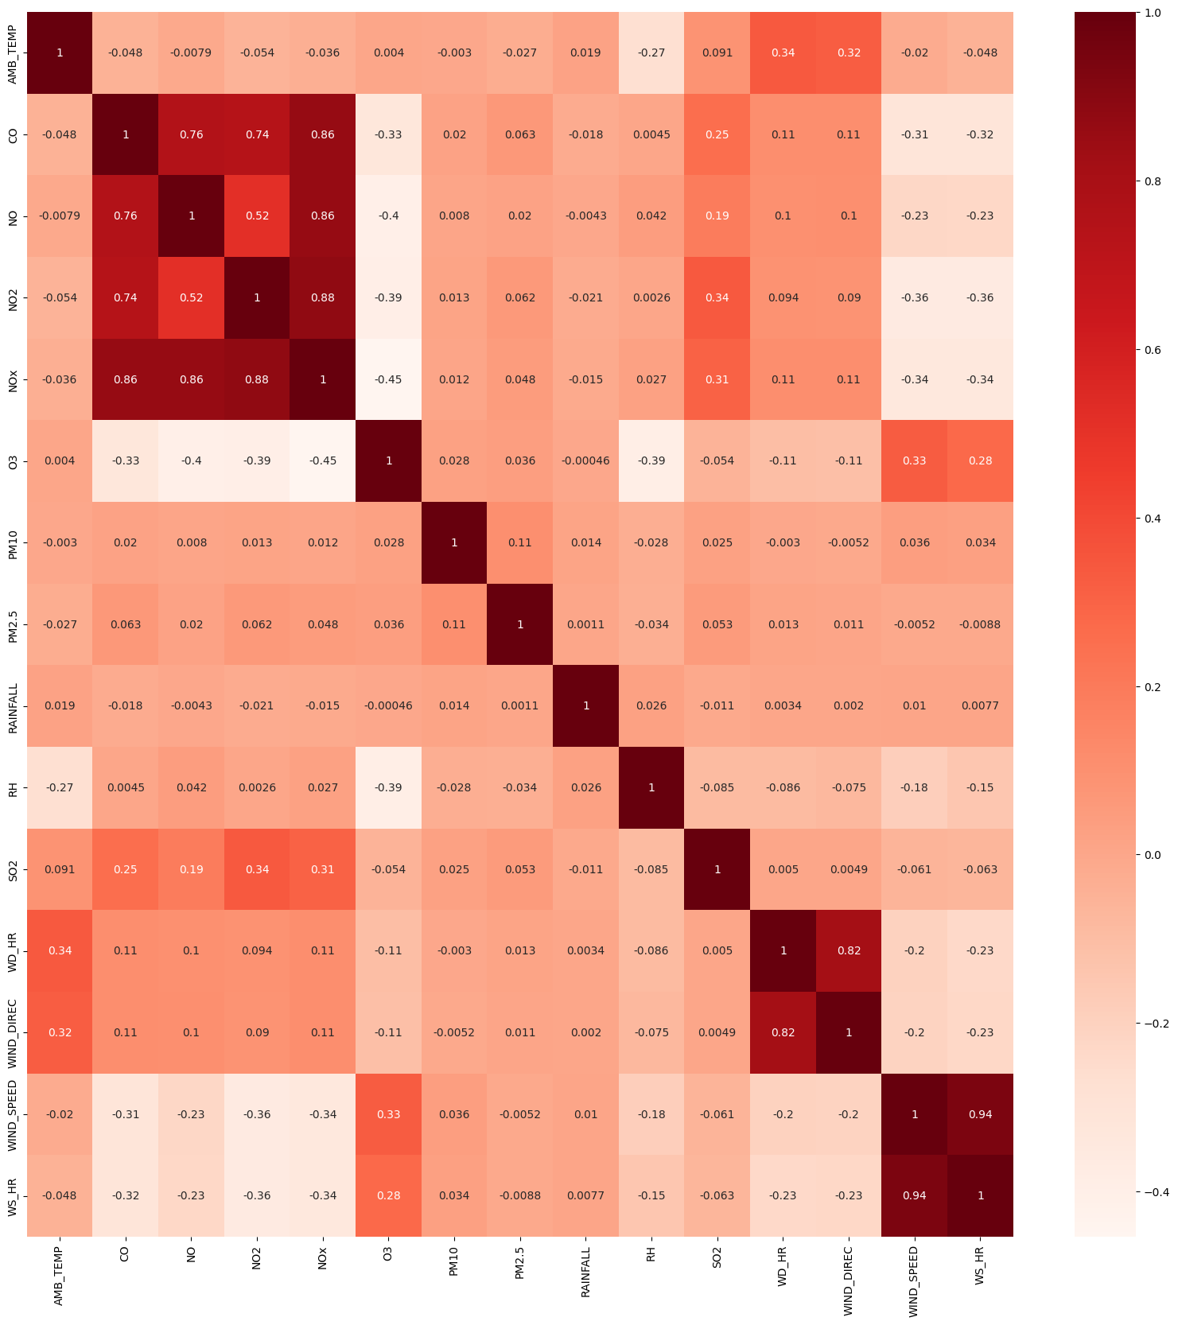
Heatmap
NOx Family Strong Correlation
CO, NO, NO2, and NOx show very strong positive correlations (0.74-0.88), suggesting common emission sources.
Wind Parameter Pairs
WD_HR/WIND_DIREC (0.82) and WIND_SPEED/WS_HR (0.94) show expected strong correlations as they measure similar parameters.
O3 Negative Relationships
O3 shows negative correlations with NO, NO2, and NOx (-0.33 to -0.45), typical of urban air chemistry.
Weak Particulate Correlations
PM10 and PM2.5 show surprisingly weak correlations with other pollutants, suggesting independent sources.
Temperature Effects
AMB_TEMP shows moderate positive correlation with wind direction (0.32-0.34) but negative correlation with RH (-0.27).

Slide 9
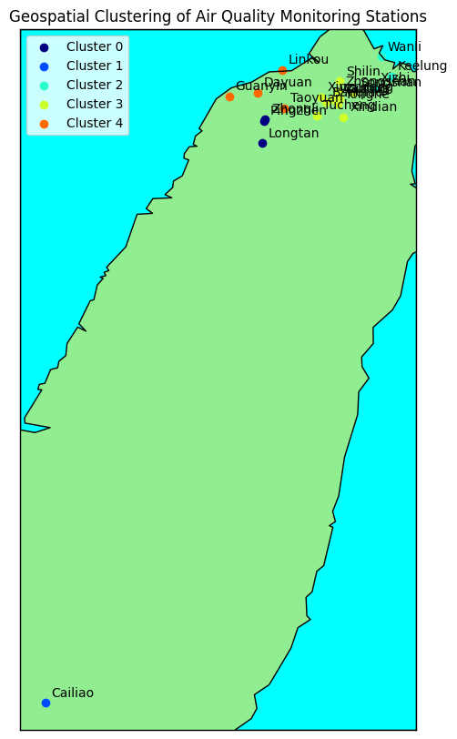
Geo-spacial clustering
Cluster 0: Central-Western Region
Consists of Longtan, Pingzhen, and Zhongli
Forms a concentrated cluster in the central-western area
These are primarily urban-suburban areas in Taoyuan City
Cluster 1: Southern Station
Contains only Cailiao
Located in the southern part of the map
Represents an isolated monitoring point
Cluster 2: Northern Coastal Region
Includes Keelung, Wanli, and Xizhi
Positioned along the northern coast
Represents coastal urban areas with potentially distinct air quality patterns
Cluster 3: Greater Taipei Metropolitan Area
Largest cluster with 10 stations
Includes major urban centers like Banqiao, Songshan, and Zhongshan
Concentrated in the densely populated Taipei basin
Cluster 4: Northwestern Region
Comprises Dayuan, Guanyin, Linkou, and Taoyuan
Located in the northwestern part
Represents areas with significant industrial and transportation activities
This clustering can help in:
Optimizing air quality monitoring strategies
Understanding regional pollution patterns
Developing targeted environmental policies
Resource allocation for air quality management

Slide 10
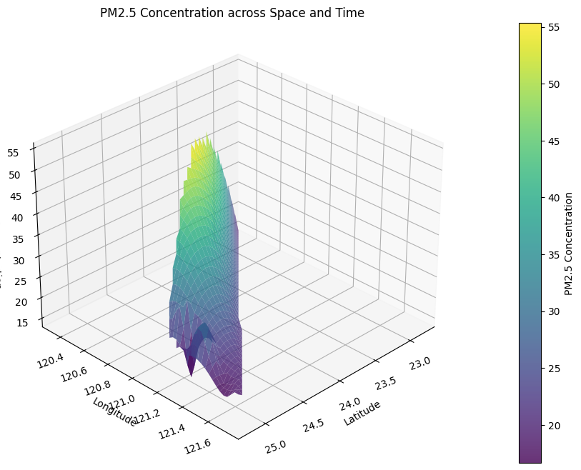
3D - plot
The observation that PM2.5 pollution levels are higher near areas with a greater density of monitoring stations

Slide 11
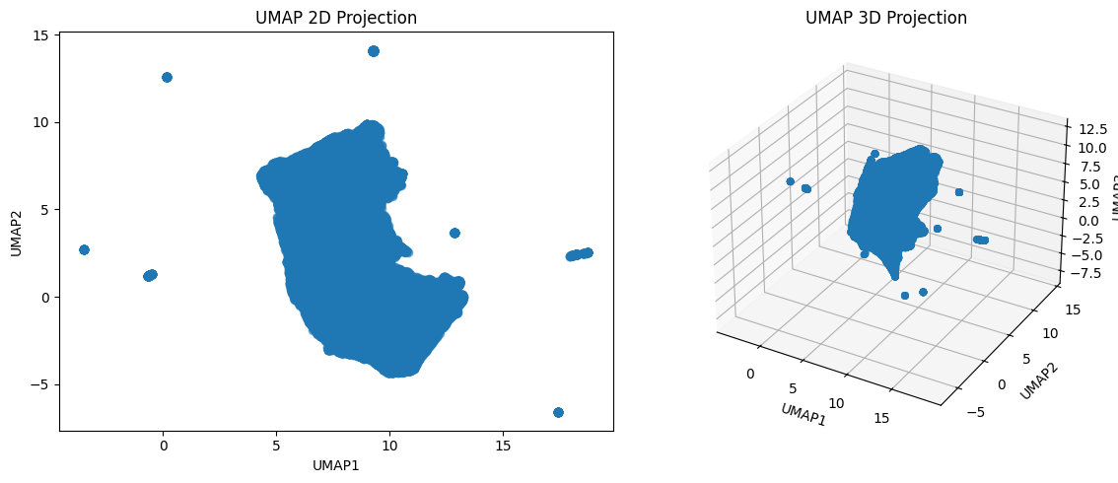
Feature Reduction

Slide 12
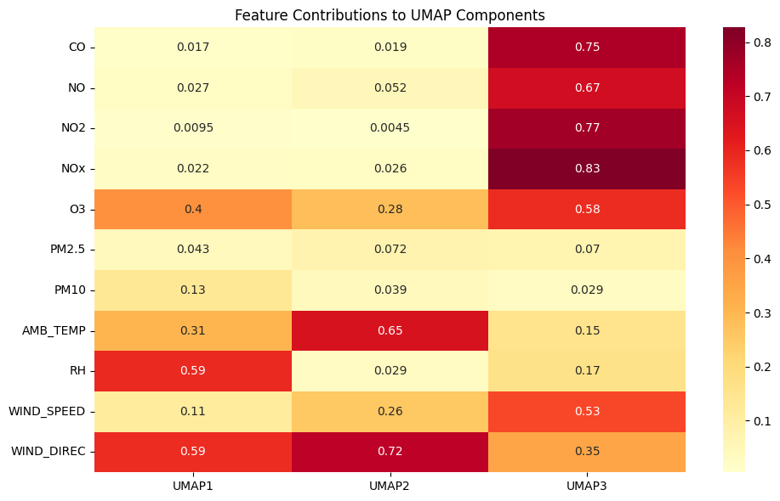
Feature Reduction cont

Slide 13
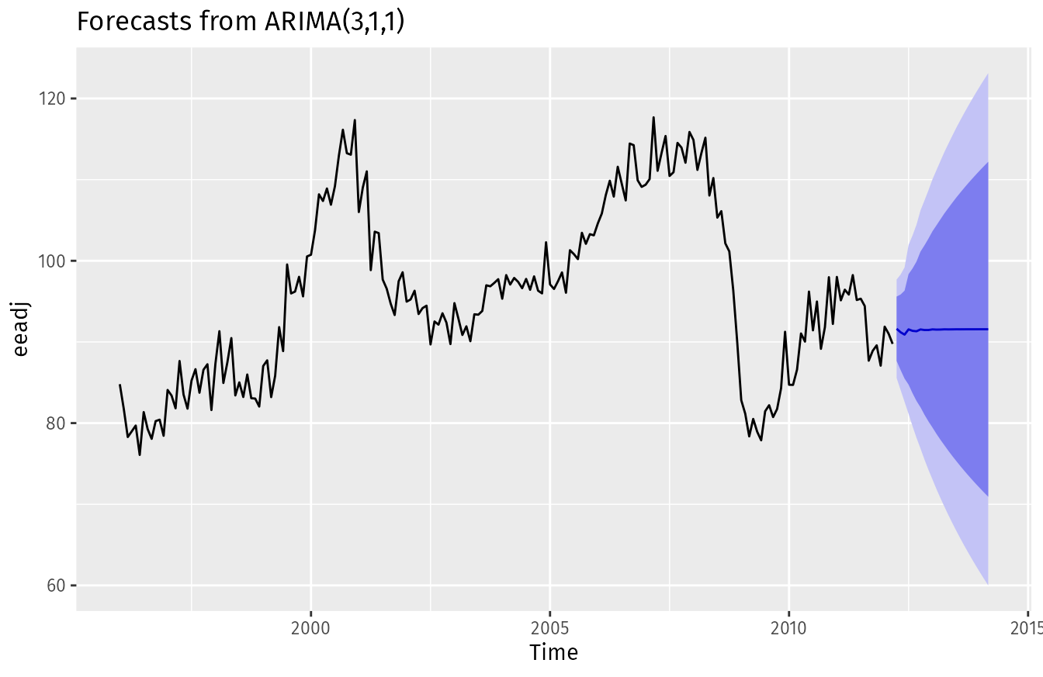
Proposed models
LSTM
ARIMA

